Slide 1
Donnerstag, den 12. März
Das Wochenende
Lernziel: To write about we do/did in our free time.

Slide 2
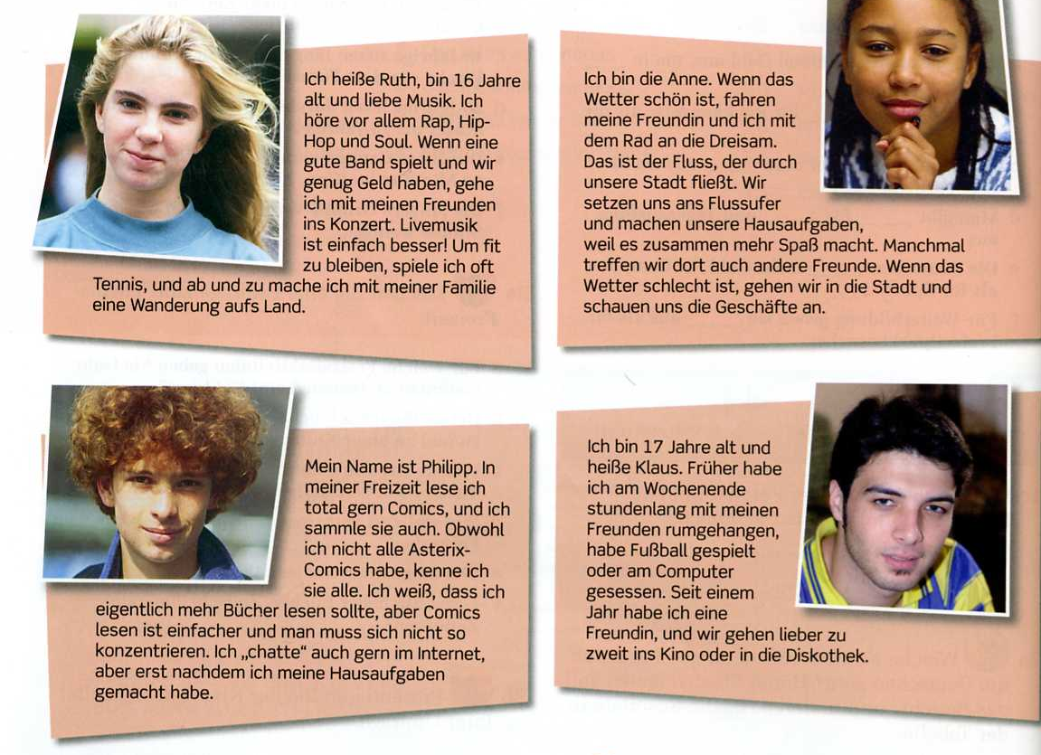

Slide 3

http://www.nthuleen.com/teach/grammar/perfect1.html

Slide 4
Write a short paragraph (around 100 words) about what you normally do at the weekend and what you did last weekend.
Include a comparative or a superlative.
Include at least one sentence in the perfect tense.

